Slide 1

Business Management System - Group 7
Safrin Patil
Aastha Bhargav
Karan Patel

Slide 2

Agenda
Introduction
Key Components
Project Requirements
Assumptions
Logical Design
Query Writing & Database Programming
Performance Tuning
DBA Scripts
User Interface Mockups
Data Visualization
Future Scope
Conclusion and References

Slide 3

Introduction
In today's fast-paced and competitive business landscape, effective business management is vital for organizations to thrive and succeed.
A well-structured and efficiently managed business ensures operational excellence, customer satisfaction, and overall profitability.
Our project, a comprehensive Business Management System (BMS), is designed to streamline and enhance business management processes.

Slide 4
Key Components
Service Category and Services: Simplifies management and categorization of business services.
Business Management: Manages business details, contact info, and operational status.
Service Levels and Offerings: Provides tiered service levels with transparent pricing.
Employee Management: Integrates employee roles, responsibilities, and details for management.
Batches: Organizes student batches for educational and training institutions.
Customer Information: Manages customer data for enhanced relationship management.
Membership Types: Offers various membership types with discounts for loyalty programs.
Student Management: Administers student info, enrollment, and membership types.

Slide 5

Project Requirements
Service Management: Add, edit, and delete services and categories with pricing levels.
Business Information Management: Create and update business profiles including operational details.
Employee Management: Handle employee information and roles.
Student Management: Register students and manage their details and batch associations.
Customer Management: Manage customer information and track sources.
Data Query and Reporting: Perform queries and generate reports with data filtering and exporting.
Data Visualization: Access tools for visual analysis of business performance and customer behavior.

Slide 6
Assumptions
Basic training is provided with potential need for advanced training on specific functions.
Users should have a stable internet connection, despite potential connectivity issues.
A fundamental understanding of security practices is presumed, with enforced data protection.
The system is designed for moderate growth with consideration for future expansion.

Slide 7
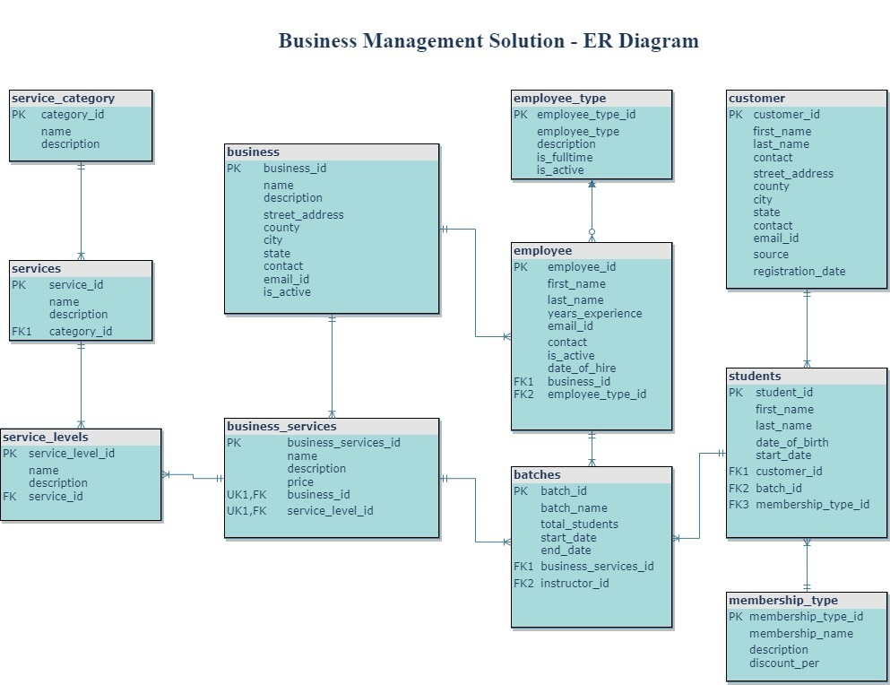
Logical Design

Slide 8
Query Writing & Database Programming
Queries:
Structured Business Views: Retrieves organized business and service level data.
Service Price Point Comparison: Filters businesses providing specific services within set price ranges.
Student Enrollment Analysis: Counts students per service to gauge popularity.
Database Programming:
Central to BMS, utilizing stored procedures, functions, and triggers for data management.
Key Stored Procedures:
Manage_business: Adds, modifies, and deletes business details.
Manage_batches: Manages course batches with start/end dates and associated services.
Manage_customer & employees: Maintains customer and employee records.
Manage_services & students: Handles services offered and student enrollments

Slide 9

Performance Tuning
Objective: Enhance system efficiency and responsiveness by reducing delays and resource consumption.
Focus Areas: Database query optimization, server configuration fine-tuning, application code refinement.
Index Usage:
IX_BS_PRICE: Indexing on price in business_services to expedite query performance.
Impact: Significant CPU usage reduction and faster execution times.
Balance: Indexes improve read performance but may affect the speed of data updates.
Performance Insights:
Reduced CPU cost from 3% to a more efficient usage post-index application.
Enhanced data access with fewer consistent gets and no need for sorting.
Improved resource utilization and quicker data retrieval.

Slide 10

DBA Scripts and Security
DBA Scripts:
Constraint Checking: Retrieves constraints details on tables, essential for data integrity verification.
Table Storage Monitoring: Shows table sizes, useful for tracking growth and managing storage.
Schema Tables Listing: Lists all tables within a schema, aiding in database structure overview.
Session SQL Display: Presents SQL statements from current database sessions for monitoring.
Security:
Access to the system is controlled by authentication mechanisms overseen by system administrators.
User Roles:
Admin: Complete system access for business operations and strategic decisions.
Employee: Role-specific access for Managers, Receptionists, Housekeeping, Instructors.
Archival Trigger: trg_customer_student_history captures and archives historical customer-student interactions, ensuring compliance and data integrity.

Slide 11

User Interface Mockups
Watermelon Swim Booking Page:
Streamlined service reservation with intuitive selection for services, personal details, and service levels.
Dynamic presentation of batches ensures personalized experiences and optimized resource allocation.
Customer Options:
Membership selection.
Variety of service levels and batch availability choices.
Admin Management Page:
Central hub for service, customer, employee, and batch management.
Ensures smooth operations and high customer satisfaction.
Key Admin Functions:
Service Management: Modify service offerings to align with customer preferences.
Customer Administration: Maintain and manage customer profiles and records.
Employee Oversight: Oversee employee details and records, with the ability to make updates.
Batch Management: Control the scheduling and allocation of swim classes.

Slide 12
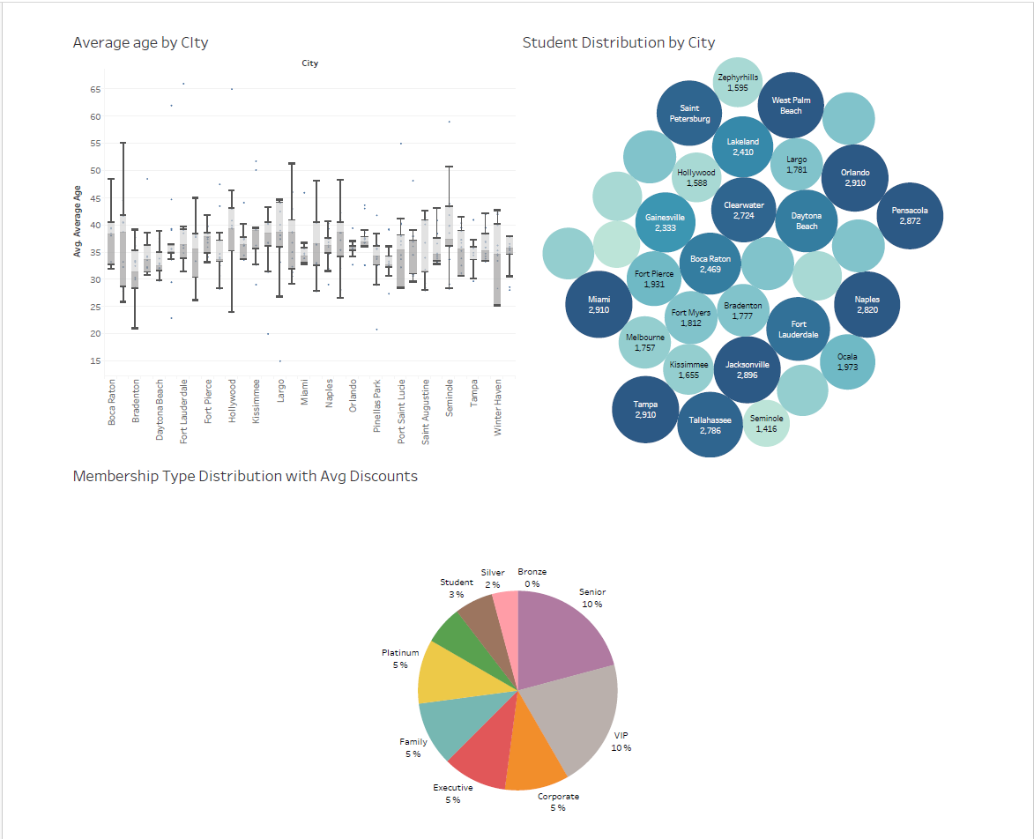
Data Visualization
Data Visualization
Logical Design

Slide 13

Future Scope
Scheduling and Appointment Management:
Develop an advanced module for efficient handling of appointments with features like automated reminders and self-scheduling options for customers.
Online Payment System:
Integrate a secure payment gateway supporting credit cards, digital wallets, and various online payment methods for smooth transactions.
Inventory Management:
Incorporate inventory tracking, replenishment management, and synchronization of inventory with sales and services.
Role-specific Access and Privileges:
Improve security by expanding access control, ensuring users have permissions tailored to their roles for operational efficiency and data protection.

